Slide 1
BI-Chicago Crime
Yang Liao
The University of Chicago
liaoy@uchicago.edu

Slide 2
Project Introduction
Objective: Develop a BI solution to present and analyze crime in Chicago city
Data source: Data Portal of City of Chicago
https://data.cityofchicago.org/Public-Safety/Crimes-2001-to-present/ijzp-q8t2
BI tools: SQL Server 2016, SSIS and SSRS

Slide 3
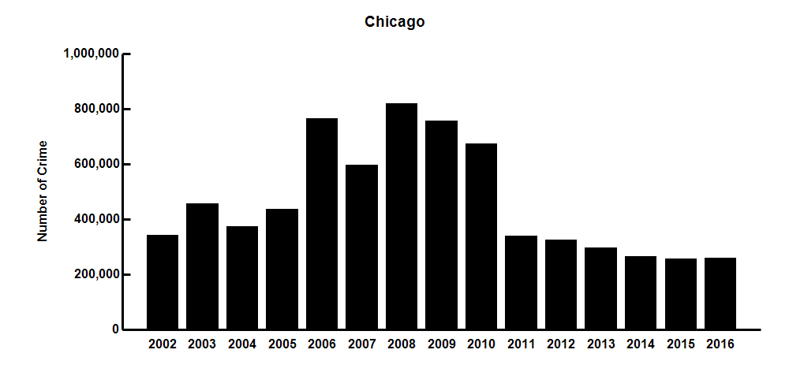
Chicago Crime (2002-2016)

Slide 4
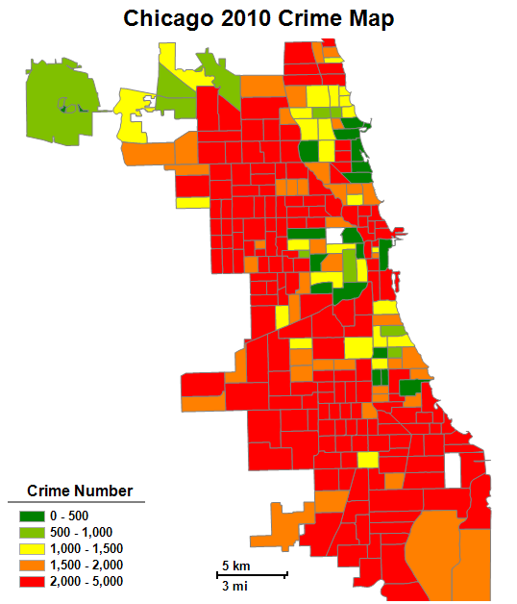
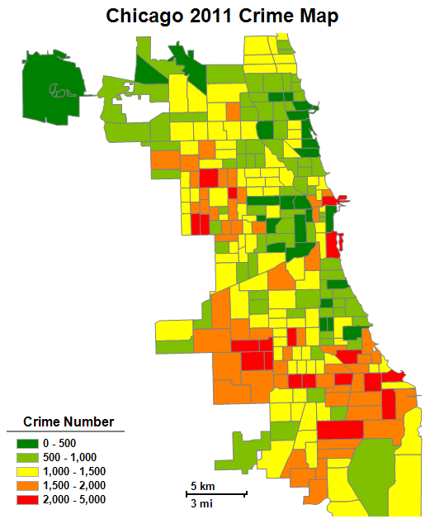
Chicago Crime Map (2010 vs 2011)

Slide 5
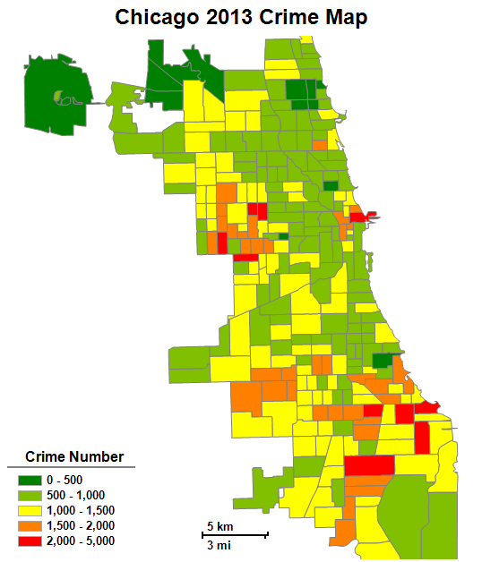
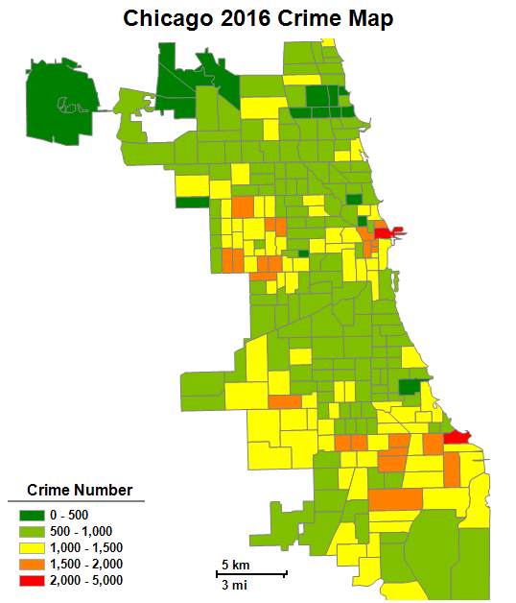
Chicago Crime Map (2013 vs 2016)

Slide 6
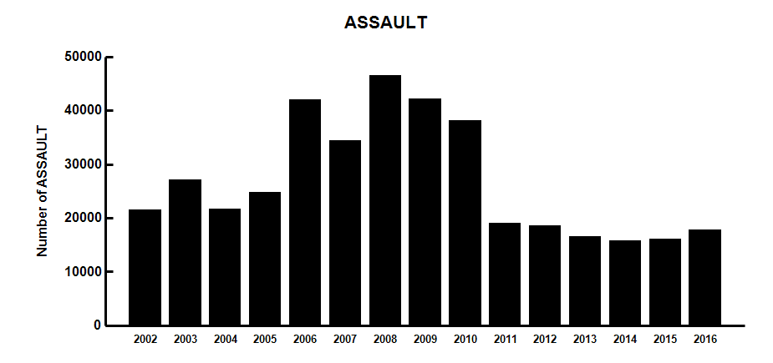
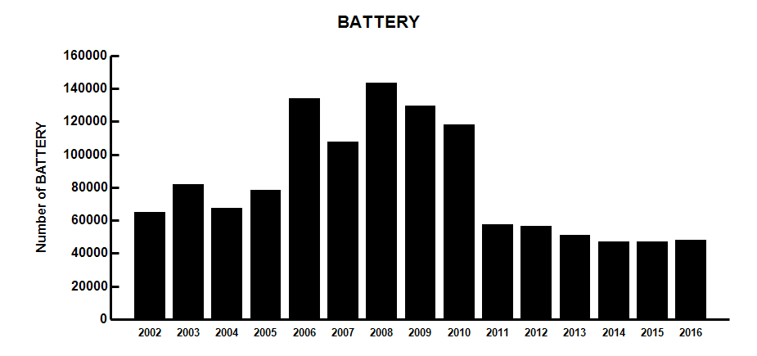
Crime Types: Assault and Battery (2002-2016)

Slide 7
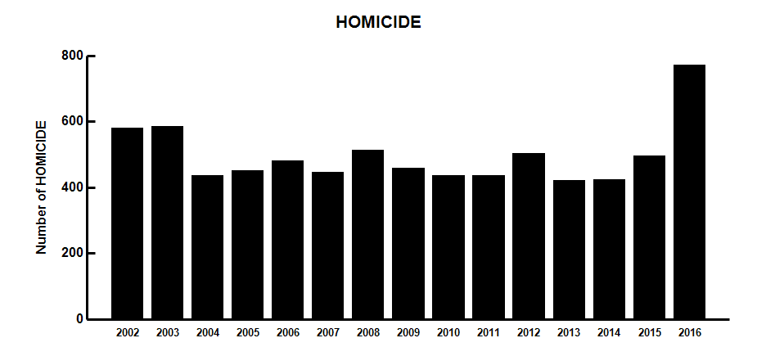
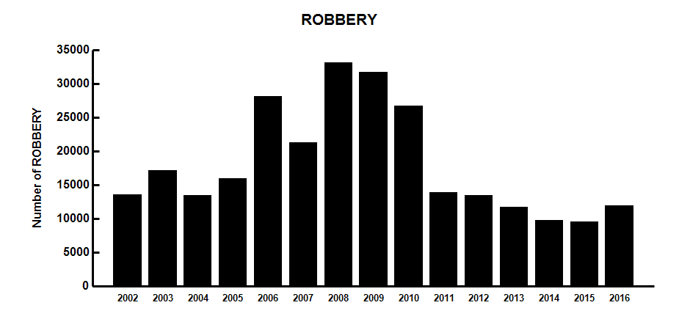
Crime Types: Homicide and Robbery (2002-2016)

Slide 8
Homicide Rank in Communities (2015 vs 2016)
2015 HOMICIDE in Communities
Community Name | Number
Austin | 50
Chatham | 23
North Lawndale | 23
Englewood | 21
Greater Grand Crossing | 18
Humboldt Park | 18
Roseland | 18
South Shore | 18
West Englewood | 18
New City | 17
2016 HOMICIDE in Communities
Community Name | Number
Austin | 88
Englewood | 49
New City | 42
West Englewood | 36
North Lawndale | 33
Greater Grand Crossing | 33
Roseland | 32
West Garfield Park | 29
East Garfield Park | 29
Humboldt Park | 28

Slide 9
Top Communities with High Crime (2010 vs 2011)
Community Name | Crime Number
Austin | 45096
South Shore | 22415
Humboldt Park | 21686
Near North Side | 21681
West Englewood | 20786
West Town | 20724
North Lawndale | 19970
Chicago Lawn | 19636
Auburn Gresham | 19445
Englewood | 18646
2010 Top 10 Communities with High Crime
Community Name | Crime Number
Austin | 21998
South Shore | 11532
Near North Side | 10968
Humboldt Park | 10590
West Englewood | 10478
Chicago Lawn | 9735
Auburn Gresham | 9716
West Town | 9690
North Lawndale | 9674
Roseland | 9281
2011 Top 10 Communities with High Crime

Slide 10
Top Communities with High Crime (2013 vs 2016)
Community Name | Crime Number
Austin | 19789
South Shore | 10371
Near North Side | 10003
Humboldt Park | 9935
North Lawndale | 9539
West Englewood | 8832
Auburn Gresham | 8339
Near West Side | 8185
West Town | 7973
Englewood | 7829
2013 Top 10 Communities with High Crime
Community Name | Crime Number
Austin | 16163
Near North Side | 10336
Near West Side | 9165
The Loop | 8831
North Lawndale | 8364
West Town | 8003
South Shore | 7989
Humboldt Park | 7724
Auburn Gresham | 7348
West Englewood | 6796
2016 Top 10 Communities with High Crime

Slide 11
Top Communities with Low Crime (2010 vs 2011)
Community Name | Crime Number
Edison Park | 548
Burnside | 837
Forest Glen | 1288
Hegewisch | 1376
Mount Greenwood | 1583
Oakland | 1591
Montclare | 1678
North Park | 2075
Pullman | 2245
Fuller Park | 2274
2010 Top 10 Communities with Low Crime
Community Name | Crime Number
Edison Park | 338
Burnside | 423
Forest Glen | 584
Mount Greenwood | 643
Oakland | 768
Hegewisch | 776
Montclare | 821
North Park | 1034
Pullman | 1038
Fuller Park | 1156
2011 Top 10 Communities with Low Crime

Slide 12
Top Communities with Low Crime (2013 vs 2016)
Community Name | Crime Number
Edison Park | 292
Forest Glen | 436
Burnside | 457
Mount Greenwood | 579
Montclare | 629
Hegewisch | 697
Oakland | 702
North Park | 845
Beverly | 1000
Pullman | 1004
2013 Top 10 Communities with Low Crime
Community Name | Crime Number
Edison Park | 292
Burnside | 384
Mount Greenwood | 565
Forest Glen | 567
Hegewisch | 568
Montclare | 655
Oakland | 688
Archer Heights | 805
North Park | 894
Fuller Park | 909
2016 Top 10 Communities with Low Crime

Slide 13
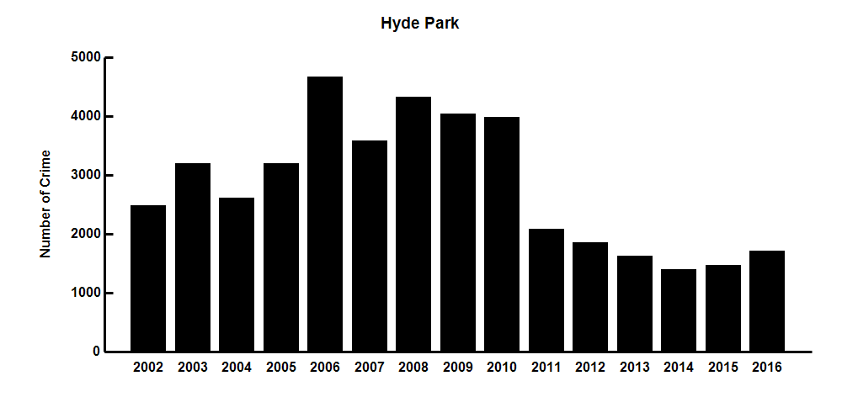
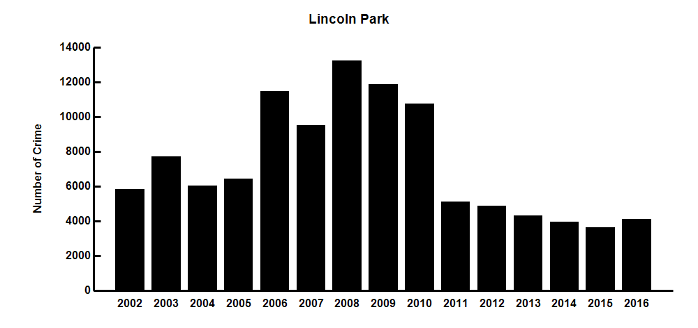
Crime in Communities: Hyde Park and Lincoln Park

Slide 14
Communities with Increased/Decreased Crime
Community Name | Decreased Crime Number
Austin | -5837
Chicago Lawn | -4068
West Englewood | -3687
South Shore | -3545
Englewood | -2882
Humboldt Park | -2868
New City | -2701
Roseland | -2650
Auburn Gresham | -2368
Greater Grand Crossing | -2126
Top Communities with Decreased Crime (2011 to 2016)
Community Name | Increased Crime Number
The Loop | 1519
Near South Side | 169
Douglas | 63
Pullman | 46
Top Communities with Increased Crime (2011 to 2016)

